Slide 1
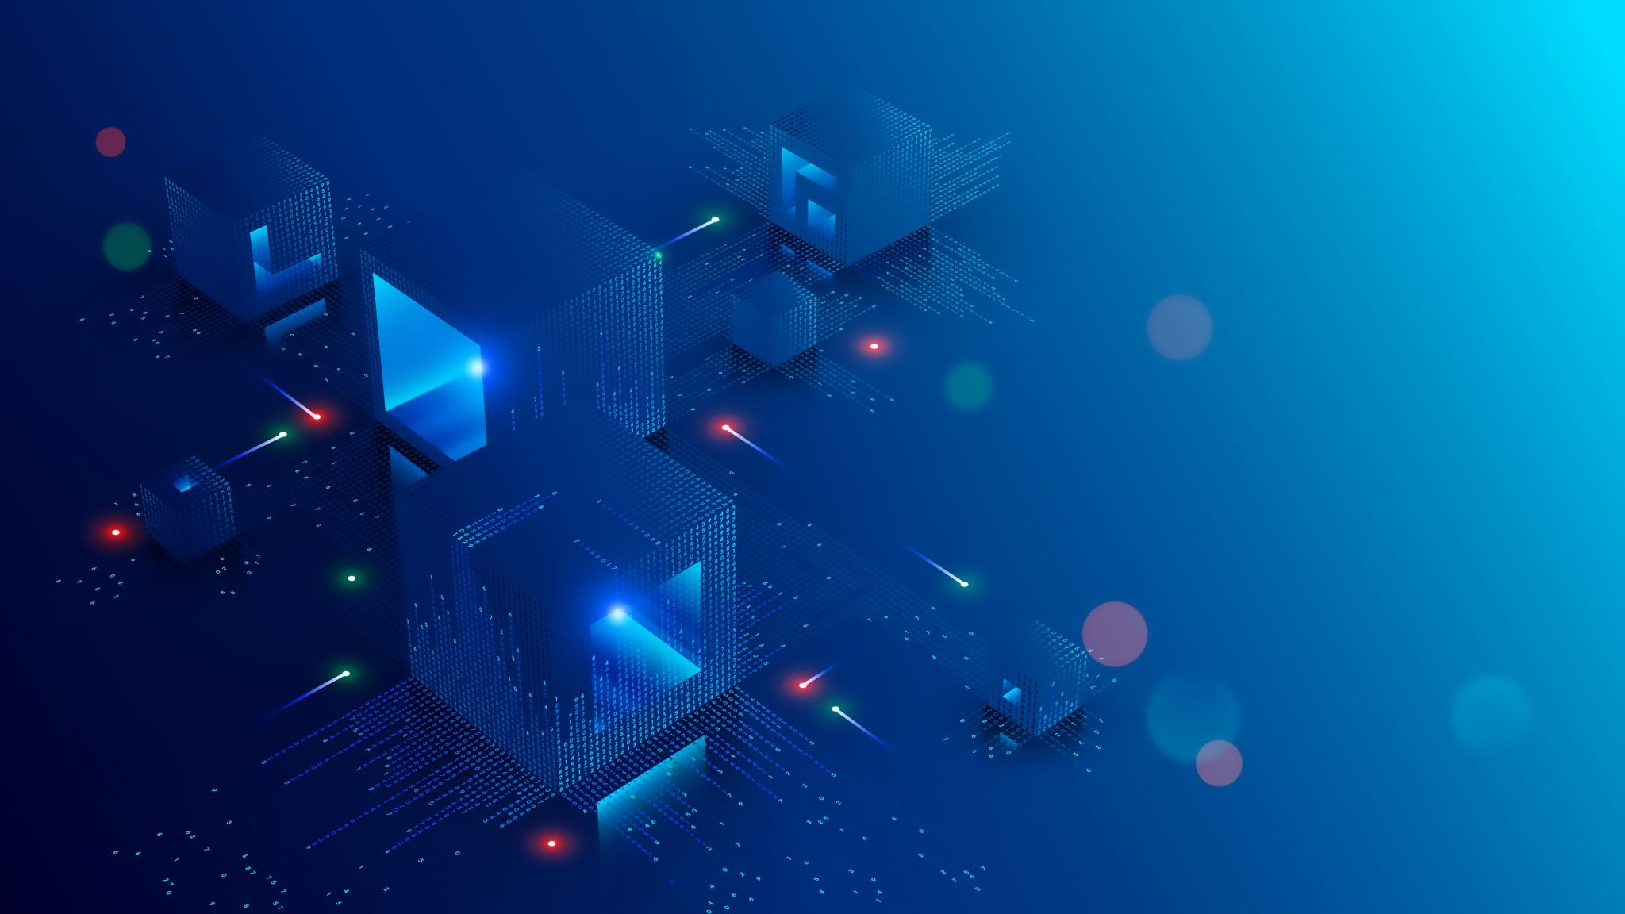
Pager Rotation Duties in the DevOps Model
Author: Robert Breutzmann
For: CSD 380 – DevOps – Assignment 7.2
Due Date: July 14th, 2026

Slide 2

What is Pager Rotation?
Pager Rotation
Pager rotation (sometimes called on-call rotation) is a schedule that assigns the responsibility for responding to incidents to a specific person (or group) for a window of time. Much like a doctor or a nurse (or team of them) is “on call” for emergencies, a developer (or team) is on call for emergencies.

Slide 3
The DevOps Shift
Ops
“Pager”
Operations side only carries the “pager.”
The Friction
Speed of delivery is a core value
DevOps
“Pager”
Developers AND Operations both have pagers.
If a system went down, the operations manager would take it offline until a developer could fix it.
Waiting for a developer downtown might be unacceptable, especially in systems that need to be up and running.
Imagine a 911 dispatch system going down on a Friday night and having to wait until Business Hours on Monday before even starting on a fix? HARD PASS.
When a System goes down, a developer is notified WITH operations.
The developer can already be working on the problem, and work with operations on what the best course of action is (is it a 5-minute fix, or does it need the full team?)

Slide 4
Why it Works
Visceral Feedback
More Developer Buy In
If a developer is “on the hook” for a 2AM phone call, they tend to care more about the quality of their commits.
Faster Fixing
Ops doesn’t need to “wake up the dev” at 2AM for a critical fix (like 911 going down). They’re already on it.
Developers get more direct feedback about the issue, making it easier to get to the root cause.

Slide 5
Structuring a Rotation
Cadence
Round Robin
Shadow Rotations
The frequency of the rotation is called the Cadence.
Engineers cycle through a fixed rotation.
Newer Developers will often "shadow" call the more experienced devs so they are not on call alone.
C an be daily, weekly or something between.
This spreads the responsibility and builds experience across the team.
They respond to calls and see how to handle them before being left on their own.
First Call
“Primary Page” Developer
Second Call
First Caller can’t or doesn’t answer.
Third Call
Depending on the system.
Time limit to respond
Call the “Backup Page”
Could be Development Manager or Operations.
Sometimes the first caller is already on a call.

Slide 6
Setting Healthy Limits
Time Spent on call should be accounted for, not just time WORKED on call
Google’s SRE has a guideline that you should spend 50% of time on regular operations
Google also says you should only take 2 incidents per on call shift.
If these limits are exceeded, it means you need more resources to lighten the “load per developer.”

Slide 7
Risks to Avoid and Mitigate
Burnout
65% of engineers report burnout - citing on-call stress as a major contributor.
Alert Fatigue / Noise
Knowledge Concentration
If the response is handled mostly by senior engineers, juniors don’t gain experience.
On-call engineers lose 30-40% of their bandwidth during a shift to incident response.
Sometimes being paged for things that are not "emergencies" (i.e., a vending machine is broken) caused them to ignore pages that matter (i.e., the 911 system is down).
Sometimes, seniors handle the problems because “they built the system anyway.” That robs juniors of the chance to learn.
Notes:
This page is almost entirely sourced from (DevOps.com, 2026).

Slide 8
Mitigation Practices
Alert Hygiene
Fairness and Analytics
Compensation
Every alert passed a simple test: Has it required human action in the last 90 days?
Rotate Equitably
Monitor Alert Volume per Person
Time on call is time spent when you must be "near your computer." Means, can't go on a date, to the movies, etc.
This time should be "compensated" because it's time the employee cannot fully "unplug" from work.
Quarterly Review
Rotation Design should be revisited regularly (Quarterly is a standard)
Team size, services, alert volume can change over time
What worked six months ago, might not work today.
If not, cut it or automate the response.

Slide 9
Tying it Back to DevOps
“On Call” developers are a natural evolution to the world of “always online” and “always awake.” DevOps is all about delivering at speed and fixing things when they break. Things don’t always break during business hours!
Pager Rotation ensures that every developer gets experience fixing issues while also giving developers time to completely “unplug” from work to avoid burnout. This process helps share the ownership of the entire codebase throughout the team. Everyone owns everything, so you can adopt a “see it, fix it, ship it” mentality, and the pipeline (GitHub, for example) handles a lot of the documentation for you. (So there is still accountability, but not at the expense of the speed of shipping fixes.

Slide 10
References
Kim, G., Humble, J., Debois, P., & Willis, J. (2016). The DevOps handbook: How to create world-class agility, reliability, and security in technology organizations. IT Revolution Press.
Google. (n.d.). Being on-call. In Site reliability engineering. https://sre.google/sre-book/being-on-call/
PagerDuty. (2025, September 4). On-call rotations and schedules. https://www.pagerduty.com/resources/incident-management-response/learn/call-rotations-schedules/
DevOps.com. (2026, March 6). On-call rotation best practices: Reducing burnout and improving response. https://devops.com/on-call-rotation-best-practices-reducing-burnout-and-improving-response/

